Slide 1
Linear Data Structure Array

Slide 2

Looping
Outline
Array
Representation of arrays
One dimensional array
Two dimensional array
Applications of arrays
Symbol Manipulation (matrix representation of polynomial equation)
Sparse matrix
Sparse matrix and its representation

Slide 3
One Dimensional Array
Memory address calculation Address of an element of an array say A[ I ] is calculated using the following formula:
Address of A [ i ] = B₀ + W * ( i- LB ) Where,
B₀ is the base address of the first element of array A
W Storage Size of one element stored in the array (in byte)
i Subscript of the element whose address is to be found
LB Lower Bound of subscript, if not specified, assume 0 (zero)
Consider array B[13…19] with base address 102, size of each element if 2 byte, find address of B[17]
The given values are: B₀ = 102, LB = 13, W = 2, i = 17
Address of A [ I ] = B₀ + W * ( i -LB ), each element’s size
= 102 + 2 * (17-13)
= 102 + 2 * 4 = 110
A[i]
i-1
B₀
B₀+W(i-1)

Slide 4
Row Major and Column Major Order
Aspect | Row Major Order | Column Major Order
Memory Organization | Elements are stored row by row in contiguous locations. | Elements are stored column by column in contiguous locations.
Memory Layout Example | For a 2D array A[m][n]: [A[0][0], A[0][1], …, A[m-1][n-1]] | For the same array: [A[0][0], A[1][0], …, A[m-1][n-1]]
Traversal Direction | Moves through the entire row before progressing to the next row. | Moves through the entire column before progressing to the next column.
Access Efficiency | Efficient for row-wise access, less efficient for column-wise access. | Efficient for column-wise access, less efficient for row-wise access.
Common Use Cases | Commonly used in languages like C and C++. | Commonly used in languages like Fortran.
Applications | Suitable for row-wise operations, e.g., image processing. | Suitable for column-wise operations, e.g., matrix multiplication.

Slide 5
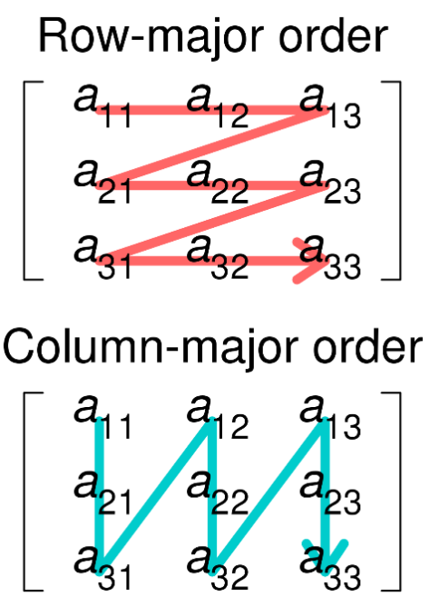
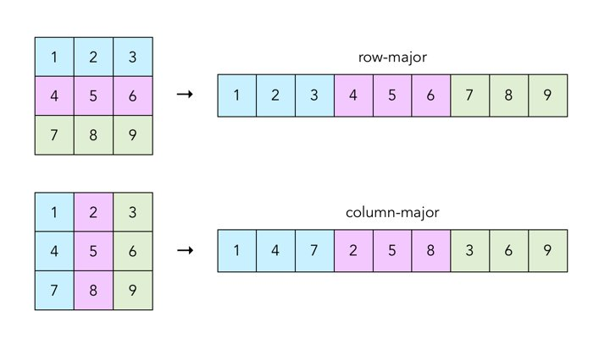
Two Dimensional Array

Slide 6
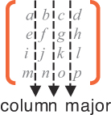
Two Dimensional Array
Two dimensional arrays are also called table or matrix
Two dimensional arrays have two subscripts
Column major order matrix: Two dimensional array in which elements are stored column by column is called as column major matrix
Two dimensional array consisting of two rows and four columns is stored sequentially by columns :
A[1,1], A[2,1],
A[1,2], A[2,2],
A[1,3], A[2,3],
A[1,4], A[2,4]
Col-1
Col-2
Col-3
Col-4
Row 1
[1,1]
[1,2]
[1,3]
[1,4]
Row 2
[2,1]
[2,2]
[2,3]
[2,4]

Slide 7
Column major order matrix
Col-1
Col-2
Col-3
Col-4
Row 1
[1,1]
[1,2]
[1,3]
[1,1]
[1,2]
[1,3]
[1,4]
Row 2
[2,1]
[2,2]
[2,1]
[2,2]
[2,3]
[2,4]
The address of element A [ i , j ] can be obtained by expression
Loc (A [ i , j ]) = B₀ + (j-1)*2 + (i-1)
Loc (A [2, 3]) = B₀ + (3-1)*2 + (2-1) = B₀ + 5
In general for two dimensional array consisting of n rows and m columns the address element A [ i , j ] is given by
Loc (A [ i , j ]) = B₀ + (j-1)*n + (i – 1)

Slide 8
Row major order matrix
Row major order matrix: Two dimensional array in which elements are stored row by row is called as row major matrix
n = no of rows, m = no of columns
[1,1]
[1,2]
[1,3]
[1,m]
[2,1]
[2,2]
[2,3]
[2,m]
[n,1]
[n,2]
[n,3]
[n,m]
nxm
The address element A [ i , j ] is given by
Loc (A [ i , j ]) = B₀ + (i-1)*m + (j – 1)

Slide 9
Examples: Address calculation
Consider 30 X 4(m x n) 2D array and the base address is 200 and 1 word per memory location. Find out the address of A (15, 3). Given Base (A) = 200, m =30, n=4, i=15, j=3, w=1
Row-by-row
Location (A [i, j]) = Base (A) + w [n (i-LB) + (j -LB)]
Location (A [15, 3]) = 200 + 1 [4 (15 - 1) + (3 - 1)]
= 200 + 1 [56 + 2] = 258
Column-by-column
Location (A [i, j]) = Base (A) + w [m (j-LB) + (i -LB)]
Location (A [15, 3]) = 200 + 1 [30 (3 – 1) + (15 – 1)]
= 200 + 1 [30 (2) + 14] = 274

Slide 10
A [2:11] indicates that A is a 1D array with lower bound (LB) of row is 2 and Upper Bound (UB) of row is 11.
Find A[5], consider each element take 2 byte with base address 100.
Address(A[i])=Base Address+(i−LB)×Size
A[-4:3] ?
A [2:11, 3:15] indicates that A is a 2D array with lower bound (LB) of row is 2 and Upper Bound (UB) of row is 11. In the same way lower bound (LB) of column is 3 and upper bound (UB) of column is 15.
Find A[5,4], consider each element take 2 byte with base address 100.

Slide 11
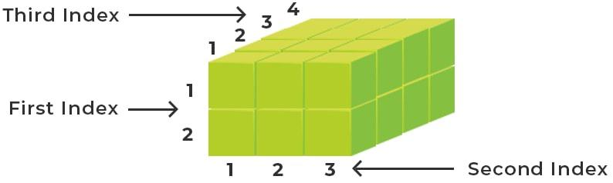
Address Calculation in 3-D Array
Suppose A is a 3D array of size M1 X M2 X M3. Total number of elements are M1 X M2 X M3. In 3D array lower bound (LB) is not always zero (0). It can be any number. Base address of any row of matrix is called effective address

Slide 12
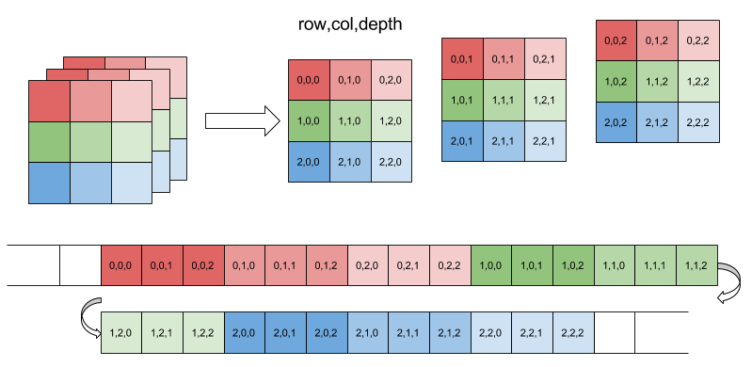
Row major of 3D array

Slide 13
Address Calculation in 3-D Array
Length of each dimension is equal to L_{i} = UB – LB +1
Lower bound (LB) may not always start with zero (0). So, we have to calculate effective address of each index.
Effective Address (E_{i}) = K_{i} - LB
Real address of any element is calculated as follows,
Row-Major: Base (A) + W [(E₁L₂ + E₂) L₃ + E₃]
Column-Major: Base (A) + W [(E₃L₂ + E₂) L₁ + E₁]

Slide 14
A[1][2][3], base(A)=100
E₁=K₁-LB₁ =1-1=0, E₂=K₂-LB₂ =2-1=1, E₃=K₃-LB₃ =3-1=2
Base (A) + W [(E₁L₂ + E₂) L₃ + E₃]
100 + 2[(0*3+1)4+2]
100 + 2[4+2]
112

Slide 15
Suppose multidimensional arrays A and B are declared using A [-2:2, 2:22] and B [1:8, -5:5, -10:5].
Here A is a 2-D array while B is a 3-D array
a). Find out the length of each dimension and the number of elements in arrays A and B.
L1 = UB –LB +1 L2 = UB –LB +1
= 2 – (-2) +1 = 5 = 22 – 2 + 1 = 21
Number of element in array A is L1 X L2 = 5 X 21 = 105.

Slide 16
B [1:8, -5:5, -10:5].
b) Consider B [3, 3, 3] elements in array B, find effective addresses E1, E2 and E3. Also, find the real address of these elements. (Assume the base address of array B is 400, and W is 4)
L1 = UB –LB +1 L2 = UB –LB +1 L3 = UB –LB +1
= 8 – 1 + 1 = 5 – (-5) +1 = 5 – (-10) +1
= 8 = 11 = 16
B is: L1 X L2 X L3 = 8 X 11 X 16 = 1408
K_{i} = 3, 3, 3 therefore K₁ = 3, K₂ = 3 and K₃ = 3
LB₁= 1, LB₂ = -5 LB₃ = -10, E₁ = K₁ – LB₁ = 3 – 1 = 2; E₂ = K₂ – LB₂ = 3- (-5) = 8; E₃ = K₃ – LB₃ = 3 – (-10) = 13;
The real address for Row Major: The real address for Row Major:
= Base (A) + W [ (E₁L₂ + E₂) L₃ + E₃] = Base (A) + W [(E₃L₂ +E₂) L₁ + E₁]
= 400 + 4 [(2 (11) + 8) 16 + 13] = 400 + 4 [(13(11) + 8) 8 + 2]
= 400 + 1972 = 400 + 4840
= 2372 = 5240

Slide 17
Representation of Polynomial equation
 | Y | Y² | Y³ | Y⁴
X | XY | XY² | XY³ | XY⁴
X² | X³Y | X²Y² | X²Y³ | X²Y⁴
X³ | X³Y | X³Y² | X³Y³ | X³Y⁴
X⁴ | X⁴Y | X⁴Y² | X⁴Y³ | X⁴Y⁴
 | Y | Y² | Y³ | Y⁴
X | XY | XY² | XY³ | XY⁴
X² | 0 | 1 | 1 | X²Y⁴
X³ | -1 | 3 | 0 | X³Y⁴
X⁴ | 1 | 0 | 0 | X⁴Y⁴
2X² + 5XY + Y²
X² + 3XY + Y²+Y-X
Y
Y²
Y³
Y⁴
Y
Y²
Y³
Y⁴
0 | 0 | 0 | 0 | 0
0 | 0 | 0 | 0 | 0
0 | 0 | 0 | 0 | 0
0 | 0 | 0 | 0 | 0
0 | 0 | 0 | 0 | 0
0 | 0 | 0 | 0 | 0
0 | 0 | 0 | 0 | 0
0 | 0 | 0 | 0 | 0
0 | 0 | 0 | 0 | 0
0 | 0 | 0 | 0 | 0
1
1
1
X
5
X
-1
3
X²
2
X²
1
X³
X³
X⁴
X⁴

Slide 18
Sparse matrix
An m x n matrix is said to be sparse if “many” of its elements are zero.
A matrix that is not sparse is called a dense matrix.
We can device a simple representation scheme whose space requirement equals the size of the non-zero elements.
Column - 1
Column - 2
Column - 3
Column - 4
Column - 5
Column - 6
Column - 7
Column - 8
0
1
2
3
4
5
6
7
8
Row - 1
0 | 0 | 0 | 2 | 0 | 0 | 1 | 0
0 | 6 | 0 | 0 | 7 | 0 | 0 | 3
0 | 0 | 0 | 9 | 0 | 8 | 0 | 0
0 | 4 | 5 | 0 | 0 | 0 | 0 | 0
Terms
Row
Column
Value
1
1
2
2
2
3
3
4
4
Row - 2
4
7
2
5
8
4
6
2
3
Row - 3
2
1
6
7
3
9
8
4
5
Row - 4
Linear Representation of given matrix
4x8

Slide 19
Different ways to initialize an Array
Method 1: Initialize an array using an Initializer List
int arr[5] = {1, 2, 3, 4, 5};
int arr[5] = {0}; all five element are zero
int arr[3][3] = {1,2,3,4,5,6,7,8,9};
Method 2: Initialize an array in C using a for loop
int arr[5];
for (int i=0; i<5; i++)
arr[i] = i; or used scanf statement
Method 3: Using Designated Initializers (For gcc compiler only)
int arr[9] = { [0 ... 8] = 10 };
int arr[9] = { 0, [1 ... 7] = 10, 0 };

Slide 20
Problem 1
Sort the given array in O(n) time
A=[0, 1, 1, 1, 0, 0, 0, 1, 1, 0]

